Slide 1
Making this resource work for you
Prior to teaching this lesson, please refer to the ‘Unit Overview and Planning Document’.
Further guidance on planning Science Mastery lessons can be found in the detailed planning guidance document.
Refer to the ‘notes’ section on each slide for useful information, including suggested expositions, pedagogical content knowledge, suggested questions, answers and more. Consider using presenter mode so you can see this guidance throughout the lesson.
The introduction slides can be adapted to suit your teaching style and the needs of your class.
Before the lesson, adapt the fix-it slide to address any misconceptions identified in the previous lesson’s exit ticket.
Choose from the suggested activities to suit your class. The intention is not that you complete all of these, but that you select those which ones are most appropriate for your students. It may be appropriate to further adapt activities for your students.
These lessons are designed to occupy approximately 1 hour. To adapt for a shorter or longer lesson duration we advise you to adapt the activity section accordingly.
Please consider using the final slide to send feedback about this lesson or examples of PowerPoints that you have adapted to our design team. Your feedback is used to improve Science Mastery for all of our teachers and students. We appreciate all suggestions and comments.
Thank you for reading!
The Science Mastery Team

Slide 2
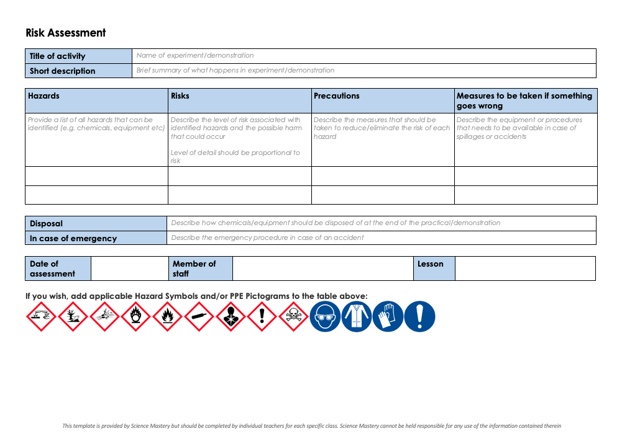
Practical Activity
This lesson contains a practical activity (either a whole class activity or a demonstration)
A risk assessment must be completed for this practical
The template risk assessment can be found here.
The risk assessment should be specific to the class involved and written only by the teaching member of staff
The risk assessment should refer to the current CLEAPSS Hazcards for all chemicals used in the practical for safety and disposal notes.
A list of chemicals used can be found in the Practical Guide
It is good practice for students to wear safety spectacles during all class practicals and demonstrations
Thank you for reading!
The Science Mastery Team

Slide 3
Diffusion
Answer the questions below:
Describe the process of gas exchange in the lungs.
Describe the movement of particles in liquids and gases.
Explain why a stain is added to a specimen on a microscope slide.
Calculate the volume of this cube (side 2 cm).
Calculate the surface area of the same cube.
Oxygen enters the lungs and diffuses into the alveoli. Carbon dioxide diffuses out of the alveoli.
Particles in a liquid can move past each other whereas particles in a gas can move freely. Particles in both move randomly in all directions.
To allow the structures to be seen more easily.
Volume = length x width x height
= 2 cm x 2 cm x 2 cm
= 8 cm³
Surface area = length x width x number of faces
= 2 cm x 2 cm x 6
= 24 cm²
Notes:
Foundation: Draw particle diagrams to show the arrangement of particles in a solid, a liquid and a gas.
Stretch: A student investigated the effect of temperature on the rate of diffusion of a food colouring in water. Identify the independent and dependent variables and a suitable control variable.
Answers:
Foundation: often pupils will draw the liquid particle diagram as a middle ground between a solid and a gas. It is important to stress that the particles in a liquid are still very close together, although they are not arranged in a fixed structure. When pupils draw a liquid particle diagram there should not be large gaps between the particles:
Stretch: Independent variable = temperature
Dependent variable = rate of diffusion or time taken for colouring to diffuse
Control variable = volume of water, number of drops of food colouring

Slide 4
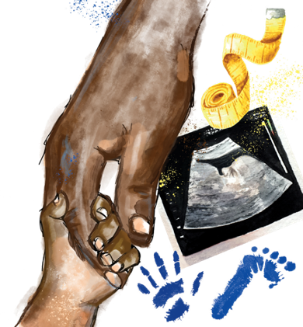
B3.1.7
21/10/2024
Diffusion
B3.1.1 Prior Knowledge Review
B3.1.2 Eukaryotic and Prokaryotic Cells
B3.1.3 Aseptic Technique
B3.1.4 Growth of Bacteria
B3.1.5 Microscopes
B3.1.6 Observing Cells
B3.1.7 Diffusion
B3.1.8 Diffusion in Living Things
B3.1.9 Osmosis
B3.1.10 Osmosis Investigation
B3.1.11 Active Transport
B3.1.12 Cell Division
B3.1.13 Cancer
B3.1.14 Stem Cells
Notes:
Big Idea: Cells are alive
So far in this unit pupils have looked at different types of cells and sub-cellular structures and how to view these under different microscopes. For the rest of the unit they will be looking at cellular processes, starting with diffusion before moving on to osmosis and active transport. Pupils will already be familiar with the idea of diffusion from C1.1, but this lesson will now introduce diffusion in a biological context, along with its importance to life.
Suggested Hook:
Either demo with a spray or ask pupils to imagine that perfume has been sprayed in the corner of the room. Who will smell it first? Then who next and so on? Then ask pupils why and link to particle theory. Safety – if spraying an aerosol in this demo, check that there are no students who suffer with asthma before continuing.

Slide 5

Following this lesson, students will be able to:
Define diffusion
Describe what is meant by concentration gradient
Explain why surface area to volume ratio decreases with size
Key Words:
diffusion
concentration
gradient
permeable
surface area to volume ratio

Slide 6
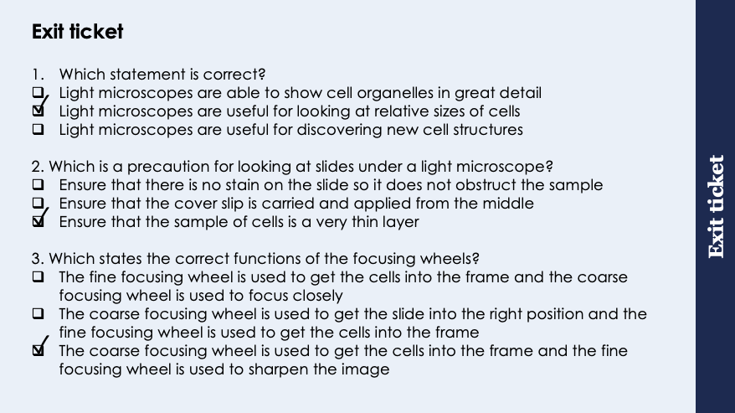
This is the fix-it portion of the lesson
The fix-it is an opportunity to respond to gaps in knowledge, especially those identified by the previous lesson’s exit ticket.
The teacher should customise this slide as needed, to facilitate
reteach, explanation, demonstration or modelling of ideas and concepts that students have not yet grasped or have misunderstood.
practise answering specific questions or of key skills.
redrafting or improving previous work.
Notes:
Purpose: to spend time on any gaps identified in previous learning from exit ticket feedback.
Answers:
Q1. Answer: B
If pupils answered A or C they may be confusing the light and electron microscope. To fix it re go through the differences between light and electron microscope and when each one would be used.
Q2. Answer: C
If pupils answer A they may think a dark stain will not allow light to travel through. To fix it revisit the idea of stains being used to allow organelles to be seen. Pupils could practice writing a concise method for preparing and viewing a sample under a microscope, highlighting safety and accuracy precautions.
Q3. Answer: C
If pupils answer A or B they misunderstand the use of the focus wheels. To fix it pupils could practice writing a concise method for preparing and viewing a sample under a microscope, highlighting safety and accuracy precautions.

Slide 7
Diffusion
Diffusion is the spreading out of particles, of liquid or gas, resulting in net movement from an area of higher concentration to lower concentration
Diffusion can occur through a selectively permeable membrane, such as a cell membrane
During gas exchange, oxygen and carbon dioxide diffuse between the alveoli and the blood
Urea (a waste product made by cells) diffuses from the cells into the blood so it can then travel to the kidneys and excreted from the body.
Notes:
Purpose: introducing new knowledge
Type of exposition: Explanation
Suggested script:
Diffusion is a crucial process in biology; the movement of particles from an area of high concentration to an area of low concentration. You may need to explain high/low concentration, if struggling it is easy to liken it to adding squash to water that you drink. The more squash you put in the more concentrated it is so has a high concentration. As it involves particles moving, diffusion can only happen in liquids and gases (refer back to particle model if needed). Diffusion is what we called a passive process meaning that it does not require energy to take place, and will occur naturally wherever there is a concentration gradient. A concentration gradient is where there is a difference in the concentration of a substance between two areas.
Diffusion can happen across selectively permeable, also called semi permeable, membranes- an example of which is a cell membrane. This process is how particles move during gas exchange. What other examples of diffusion have we learnt about in y7/8? Absorption of nutrients in the small intestine, gas exchange in the stomata, absorption of glucose and oxygen into cells from the blood for aerobic respiration etc.
Another example of diffusion: Urea is a waste product made by cells that needs to be excreted from the kidneys. Urea diffuses from the cells into the blood where it can then be transported to the kidneys
Suggested Demo - potassium permanganate in water (only a tiny amount needed) or air freshener in a corner of the room (Safety – if spraying an aerosol in this demo, check that there are no students who suffer with asthma before continuing. ), to show diffusion happens in both liquids and gases.
Another example of diffusion in human body: Urea is a waste product that is made by cells It diffuses out of cells into the blood and is then transported to the kidneys and excreted from the body
Additional activity: https://www.youtube.com/watch?v=LUPHohqlPTU
YouTube video that describes diffusion in the body and includes factors affecting the rate of diffusion
Image: https://commons.wikimedia.org/wiki/Category:Diffusion#/media/File:Diffusion.svg

Slide 8
Diffusion
The rate of diffusion can be increased by:
An increase in temperature
An increase in the concentration gradient (the difference between the high and low concentration
An increase in surface area
Notes:
Purpose: introducing new knowledge
Type of exposition: Explanation/modelling
Suggested script:
As diffusion of particles occurs naturally, it can be affected by different factors.
Increasing the temperature of the substance will increase the rate of diffusion. Thinking about particles why will this happen? The higher the temperature the more the particles will move (the more kinetic energy they have), if particles move faster they will spread out quicker and will therefore diffuse quicker.
Increasing the concentration gradient will also increase the rate of diffusion as there will be more particles to spread out. (Concentration gradient could be likened to a slide- the steeper the gradient of the slide the faster one will travel down so the steeper the concentration gradient the faster diffusion occurs.)
Finally, an increased surface area will give a larger surface for diffusion to happen across so will also speed up diffusion. Draw a straight line and a wiggly line on the board to show how the wiggly line actually gives more space that diffusion could happen across. Where have we seen an example of increased surface area for faster diffusion before? Villi in the small intestine, alveoli in the lungs.
Suggested activity: use this PhET interactive animation to model how the rate of diffusion changes when temperature or concentration gradient are changed. https://phet.colorado.edu/sims/html/diffusion/latest/diffusion_en.html
Suggested script:
We can use our knowledge of surface area and volume to calculate a surface area : volume. This is relevant when looking at examples of how diffusion happens in different organisms.
First I need to calculate the surface area of the object, in this case it the cube has side lengths of 2cm, therefore the surface area is all surfaces added together (so 24cm³) and the volume is height x length x width (8cm³). To find the ratio I divide the SA by the volume, substituting in my values that gives me 24/8 which gives me a final SA:vol of 3. As it’s a ratio I don’t have any units for this calculation.
Suggested demo: KMNO₄ in hot water vs cold water

Slide 9
Surface area to volume ratio
Surface area to volume ratio can be calculated by dividing the surface area by the volume of a cell, an organ or organism
E.g. for this cube we have already calculated surface area to be 24 cm² and volume to be 8 cm³.
Ratio = Surface area
Volume
= 24 cm²
8 cm³
= 3

Slide 10
Quick Quiz
Determine whether each statement is true or false:
Diffusion is the spreading out of solid, liquid and gas particles from an area of higher concentration to an area of lower concentration.
Rate of diffusion can be increased by increasing the temperature.
Surface area to volume ratio is calculated by dividing the volume by the surface area.
During the process of gas exchange oxygen diffuses into the bloodstream and carbon dioxide diffuses in to the bloodstream.
Diffusion can take place through a semi-permeable membrane.
Diffusion enables urea to be transported out of cells and into the blood for excretion from the body.
False
True
False
False
True
True
Notes:
Purpose: assess understanding of new information and key prior knowledge. Get students to hold up thumbs up or down to choose whether statements are true or false. Take consensus with answers and use questioning to explain why these are the answers and correct false statements.
Answers:
False – liquids and gases only
True
False – surface area divided by volume
False – oxygen diffuses from the alveoli into the bloodstream and carbon dioxide diffuses out
True
True

Slide 11

Is this correct?
The larger the surface area to volume ratio, the larger the object
Notes:
Purpose: This is to address misconceptions around surface area and surface area to volume ratio as students often use the terms interchangeably.
Answer: This is incorrect, because a larger object will most likely have a larger surface area, but its surface area to volume ratio will be lower (SEE THE NEXT SLIDE TO PROVE WHY THIS STATEMENT IS INCORRECT).
Suggested guidance:
Talk tasks can be used in a variety of ways to suit the particular needs of the students you are teaching. Through exchanging views with others, students develop their understanding of the science beyond what could be achieved individually.
Science classrooms that successfully integrate talk have the following features:
Science talk is a regular feature of lessons and is woven into classroom activities.
Students are paired or grouped strategically by the teacher to ensure productive interaction. This might take into consideration the students’ proficiency of the English language, how encouraging they might be to peers and their attainment in the topic. It’s a good idea to consider these pairings in the class seating plan.
Students are encouraged and supported to talk, but are not forced to talk.
The teacher should take on the role of a facilitator, engaging with conversations where necessary and encouraging or steering the conversation where needed.
Students are encouraged to use the language they have to express their ideas (e.g., everyday language, imperfect English, native language), but also to incorporate science specific terminology where this is more accurate or has been taught.
6. Scientifically inaccurate ideas are not dismissed by the partner or teacher; open discussion and further investigation are relied on to help students construct ideas that support them to progress in their scientific understanding.
7. Guidelines for behaviour during talk tasks are explicit and frequently reviewed. Rules for students might be:
Listen carefully to your partner
Take turns talking.
Speak one at a time, without interrupting.
Politely agree or disagree and explain why.
Politely point out if your partner has used a scientific word incorrectly, if they have explained the science incorrectly, or if there is a more accurate way to describe something.
If confused, ask questions.
Stay focused on the discussion topic.
Respond to one another.

Slide 12
Answer
1 cm
SA = 6 cm²
Vol = 1 cm³
SA:Vol = 6
2 cm
SA = 24 cm²
Vol = 8 cm³
SA:Vol = 3
3 cm
SA = 54 cm²
Vol = 27 cm³
SA:Vol = 2
Notes:
Suggested guidance: you may wish to remove the final ratio calculation to challenge students to calculate this themselves and then discuss the talk task on the previous slide.
Answer: A larger object will most likely have a larger surface area, but its surface area to volume ratio will be lower. In this example, as the length of the side of the cube increases from 1 to 2 to 3, the SA:Vol goes down from 6, to 3 to 2.
This is why large multicellular organisms have specialised exchange surfaces such as alveoli and villi (to be discussed in the next lesson).

Slide 13

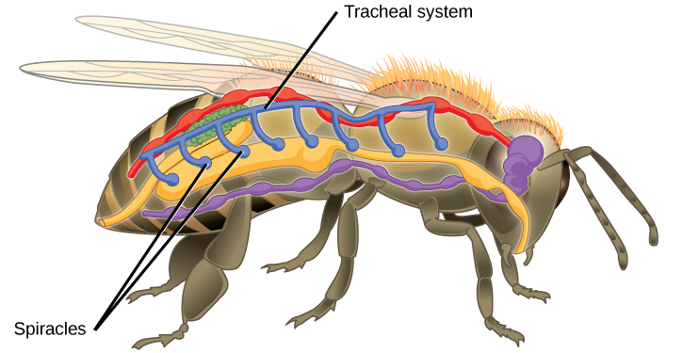
Think outside the box!
How do you think the structure of an insect is adapted for gas exchange?
HINT – the structures labelled below are involved in gas exchange
Notes:
Answer: large surface area due to tracheae, tracheoles and air sacs to increase gas exchange
Suggested guidance: The idea is to elicit the same adaptations as mentioned previously – large surface area due to tracheae, tracheoles and air sacs. This is similar to animal lungs where the shape and number of alveoli act to increase the surface area to increase the rate of gas exchange.
Image: https://commons.wikimedia.org/wiki/File:Figure_39_01_05.jpg
Suggested guidance:
Talk tasks can be used in a variety of ways to suit the particular needs of the students you are teaching. Through exchanging views with others, students develop their understanding of the science beyond what could be achieved individually.
Science classrooms that successfully integrate talk have the following features:
Science talk is a regular feature of lessons and is woven into classroom activities.
Students are paired or grouped strategically by the teacher to ensure productive interaction. This might take into consideration the students’ proficiency of the English language, how encouraging they might be to peers and their attainment in the topic. It’s a good idea to consider these pairings in the class seating plan.
Students are encouraged and supported to talk, but are not forced to talk.
The teacher should take on the role of a facilitator, engaging with conversations where necessary and encouraging or steering the conversation where needed.
Students are encouraged to use the language they have to express their ideas (e.g., everyday language, imperfect English, native language), but also to incorporate science specific terminology where this is more accurate or has been taught.
6. Scientifically inaccurate ideas are not dismissed by the partner or teacher; open discussion and further investigation are relied on to help students construct ideas that support them to progress in their scientific understanding.
7. Guidelines for behaviour during talk tasks are explicit and frequently reviewed. Rules for students might be:
Listen carefully to your partner
Take turns talking.
Speak one at a time, without interrupting.
Politely agree or disagree and explain why.
Politely point out if your partner has used a scientific word incorrectly, if they have explained the science incorrectly, or if there is a more accurate way to describe something.
If confused, ask questions.
Stay focused on the discussion topic.
Respond to one another.

Slide 14
Drill
Define diffusion
Name the two gases which diffuse between the blood and alveoli during gas exchange in the lungs
State three factors which can affect the rate of diffusion
Write the equation used to calculate surface area to volume ratio
Explain how increasing the temperature increases the rate of diffusion
Each side of a cube is 2cm long. Calculate:
The area of one face of the cube
The total surface area of the cube
The volume of the cube
The surface area to volume ratio of the cube
Notes:
Purpose: This is a knowledge drill. The purpose of this is to check that the critical knowledge is secure before pupils move onto independent practice.
Suggested guidance: There are a range of ways this could be done depending on time and ability range of the class:
Mini whiteboards
As full sentences in exercise books
As short answers in exercise books
In the pupil workbook
As pair talk
As cold call

Slide 15
Drill answers
Diffusion is the spreading out of particles, of liquid or gas, resulting in net movement from an area of higher concentration to lower concentration
Oxygen and carbon dioxide
Temperature, concentration gradient, surface area.
Ratio = Surface area
Volume
Particles gain more kinetic energy, so the particles move more and therefore spread out more quickly.
a) 4cm²
b) 24cm²
c) 8cm³
d) 3:1
Notes:
Purpose: This is a knowledge drill. The purpose of this is to check that the critical knowledge is secure before pupils move onto independent practice.
Suggested guidance: There are a range of ways this could be done depending on time and ability range of the class:
Mini whiteboards
As full sentences in exercise books
As short answers in exercise books
In the pupil workbook
As pair talk
As cold call

Slide 16

I: Describe the effect of a variable
Example question:
Describe and explain the effect of increasing temperature on the rate of diffusion.
To ‘describe’, your answer should:
Include each step of the process in a logical order.
Use keywords throughout the answer
Stay focused on the question.
To ‘explain’ your answer should:
Use ‘this means that’, ‘because’ or ‘so’ to link your statement to the question.
Model answer:
Increasing the temperature increases the rate of diffusion
This is because a higher temperature means the particles have more kinetic energy, so they move around more and spread out more quickly
Notes:
This slide models the process of answering a describe question.
Firstly, students are presented with a generic describe question, along with a model answer. Students are also given some simple guidance to follow for producing their own describe answer.
The generic question and answer should be used by the teacher to remind students of
the key features of a great answer
how to structure their answer
why the model answer is a good example
Following this, students will be required to apply this process to answer their own describe question, which will appear in place of the generic questions. This describe question will be specific to the topic students are learning about in the lesson. Give students time to write their own answer to this, ensuring that they use the guidance provided. To further scaffold this task for students, it may be appropriate to:
pair students up to write an answer together
list for students the key words you would like them to include in the answer
provide a writing frame or ‘points to include’ for students
A model answer for this question will appear. Teachers should review the model answer with students by referencing the guidance in the green box. For example ‘we can see item 1 in the guidance is to identify the general pattern in the graph. Notice in the model answer here we have done just that’. Or ‘item 2 in the guidance here says that we should separate the graph into sections and describe each section. Has this been achieved in the model answer? Where can we see this?’.

Slide 17
We: Describe the effect of a variable
Example question:
Describe and explain the effect of increasing the surface area of an object on the rate of diffusion.
To ‘describe’, your answer should:
Include each step of the process in a logical order.
Use keywords throughout the answer
Stay focused on the question.
To ‘explain’ your answer should:
Use ‘this means that’, ‘because’ or ‘so’ to link your statement to the question.
Model answer:
Increasing the surface area increases the rate of diffusion
This is because there is more surface available for diffusion to take place across
Notes:
This slide models the process of answering a describe question.
Firstly, students are presented with a generic describe question, along with a model answer. Students are also given some simple guidance to follow for producing their own describe answer.
The generic question and answer should be used by the teacher to remind students of
the key features of a great answer
how to structure their answer
why the model answer is a good example
Following this, students will be required to apply this process to answer their own describe question, which will appear in place of the generic questions. This describe question will be specific to the topic students are learning about in the lesson. Give students time to write their own answer to this, ensuring that they use the guidance provided. To further scaffold this task for students, it may be appropriate to:
pair students up to write an answer together
list for students the key words you would like them to include in the answer
provide a writing frame or ‘points to include’ for students
A model answer for this question will appear. Teachers should review the model answer with students by referencing the guidance in the green box. For example ‘we can see item 1 in the guidance is to identify the general pattern in the graph. Notice in the model answer here we have done just that’. Or ‘item 2 in the guidance here says that we should separate the graph into sections and describe each section. Has this been achieved in the model answer? Where can we see this?’.

Slide 18
You: Describe the effect of a variable
Example question:
Describe and explain the effect of increasing the concentration gradient on the rate of diffusion
To ‘describe’, your answer should:
Include each step of the process in a logical order.
Use keywords throughout the answer
Stay focused on the question.
To ‘explain’ your answer should:
Use ‘this means that’, ‘because’ or ‘so’ to link your statement to the question.
Model answer:
Increasing the concentration increases the rate of diffusion
This is because there is a larger difference in concentration
Notes:
This slide models the process of answering a describe question.
Firstly, students are presented with a generic describe question, along with a model answer. Students are also given some simple guidance to follow for producing their own describe answer.
The generic question and answer should be used by the teacher to remind students of
the key features of a great answer
how to structure their answer
why the model answer is a good example
Following this, students will be required to apply this process to answer their own describe question, which will appear in place of the generic questions. This describe question will be specific to the topic students are learning about in the lesson. Give students time to write their own answer to this, ensuring that they use the guidance provided. To further scaffold this task for students, it may be appropriate to:
pair students up to write an answer together
list for students the key words you would like them to include in the answer
provide a writing frame or ‘points to include’ for students
A model answer for this question will appear. Teachers should review the model answer with students by referencing the guidance in the green box. For example ‘we can see item 1 in the guidance is to identify the general pattern in the graph. Notice in the model answer here we have done just that’. Or ‘item 2 in the guidance here says that we should separate the graph into sections and describe each section. Has this been achieved in the model answer? Where can we see this?’.

Slide 19
Diffusion
Complete the worksheet on diffusion
Use full sentences and keywords where necessary
Try to complete the stretch activity
Notes:
Self/peer assess using markscheme
Prior knowledge from C1.1 diffusion and B2.1 gas exchange.
Image: https://commons.wikimedia.org/wiki/Category:Diffusion#/media/File:Diffusion.svg

Slide 20
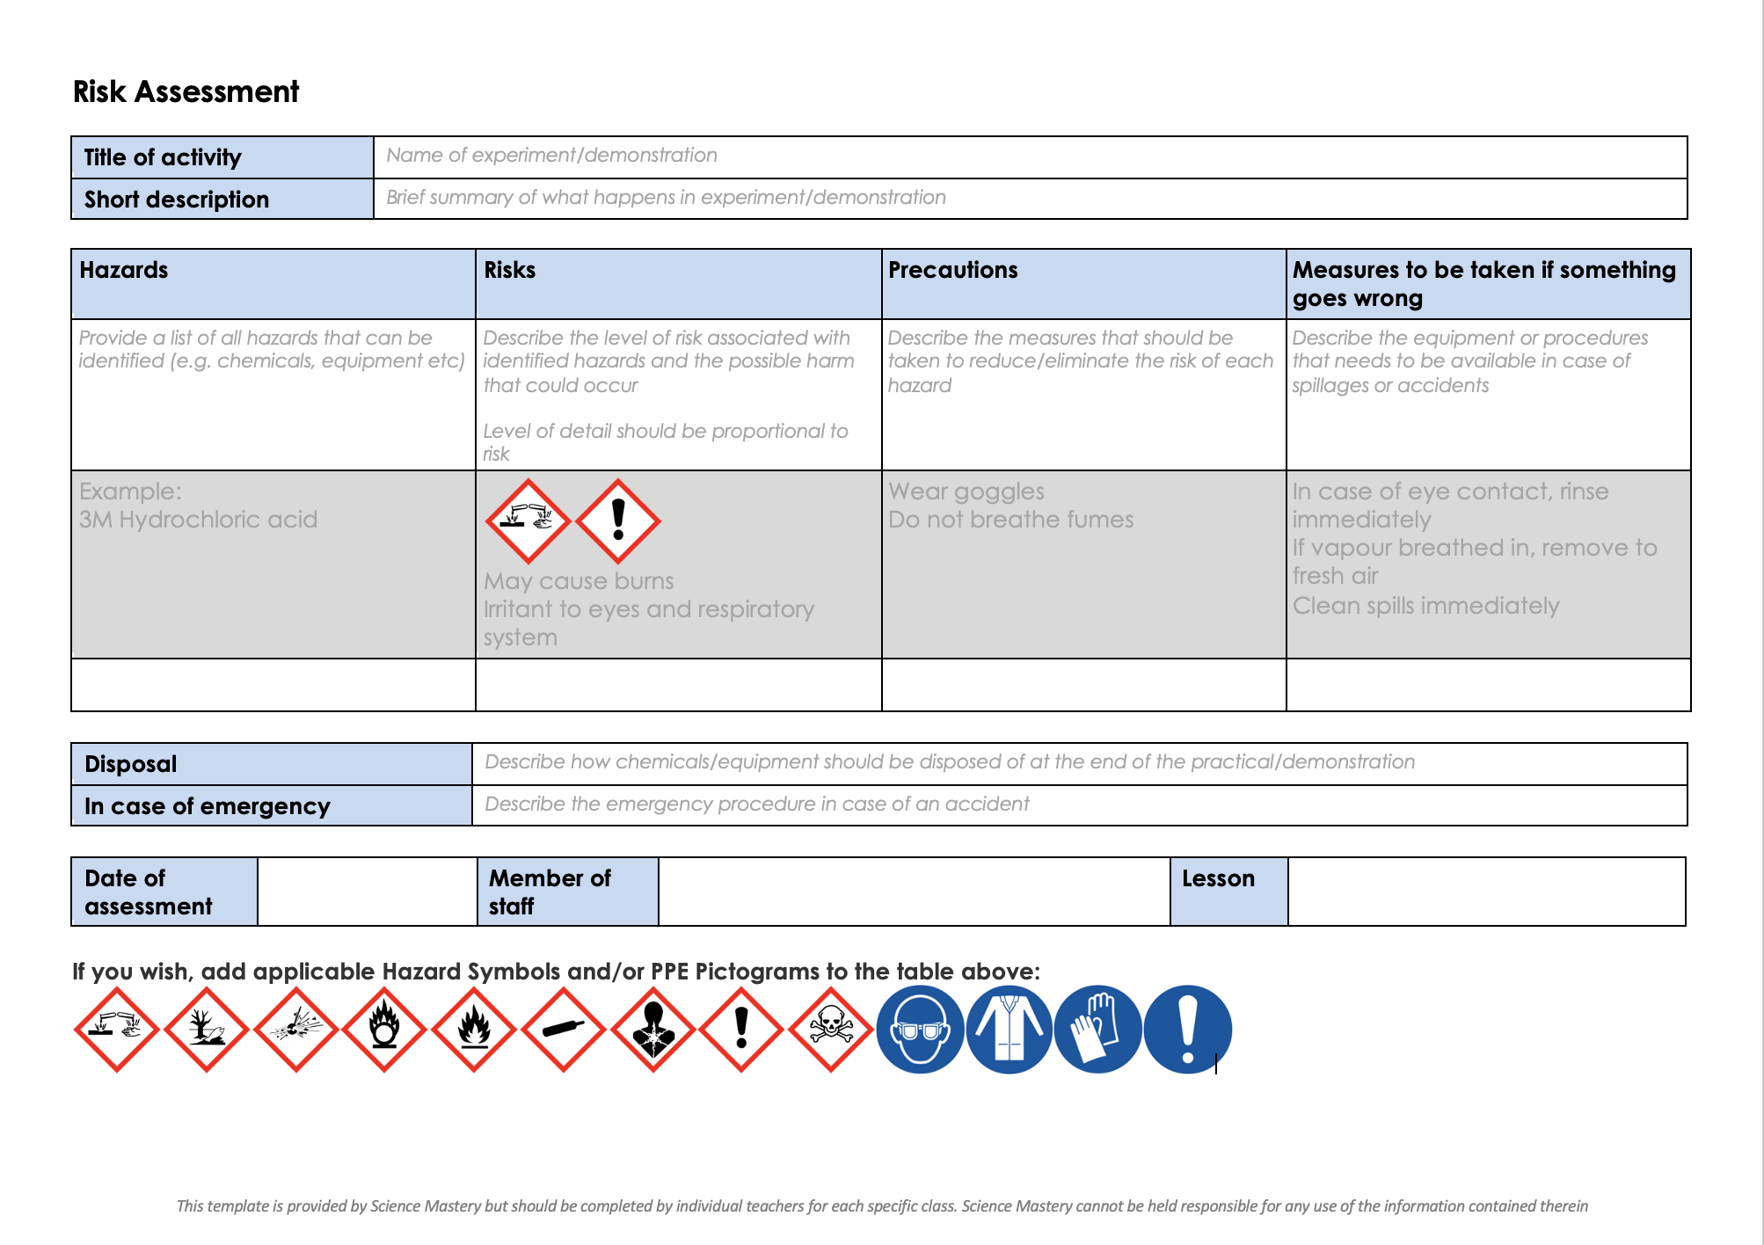
Risk Assessment
A risk assessment must be completed for this practical
The template risk assessment can be found here.

Slide 21
Effect of size on uptake by diffusion
Collect agar cubes of different sizes; 2 cm x 2 cm, 1 cm x 1 cm and 0.5 cm x 0.5 cm.
Place the cubes in a beaker and cover with the diffusing solution.
Start the stopclock.
Leave the cubes for 5 minutes
While you are waiting, complete the table with calculations for each cube.
Pour off the solution. Rinse the cubes in a little water and blot the surfaces of each cube dry with a paper towel.
Time how long it takes for the acid to change the colour of the indicator in each agar block. If the acid does not penetrate the largest block in the time available, cut the block and measure how far it has penetrated in the time.
Notes:
Suggested script: Larger organisms cannot obtain all of the nutrients they need by diffusion as unicellular organisms do. This investigation by RSB (Royal Society of Biology) shows the effect of size on uptake by diffusion. This activity incorporates the calculation of surface area to volume ratio, and so can be adapted to be quite challenging for more able students.
Investigation overview: Students will set up cubes of agar jelly and see how far liquid penetrates them by diffusion over five minutes. They will calculate surface area to volume ratio for cubes of different sizes and consider the problems faced by large organisms.
Link to activity information: https://pbiol.rsb.org.uk/exchange-of-materials/diffusion/effect-of-size-on-uptake-by-diffusion
While the cubes are soaking, students can try the calculation of surface area to volume ratio for themselves. Many students struggle with these calculations and their implications, so it’s worth taking the time to go through the calculations methodically.
Equipment needed:
Beaker, 100 cm³, 1
White tile,1
Paper towel, 1
Ruler, 1
Forceps, 1
Stopclock/ stopwatch
For the class – set up by technician/ teacher
Agar cubes 2 cm x 2 cm, 1 per group
Agar cubes 1 cm x 1 cm, 1 per group
Agar cubes 0.5 cm x 0.5 cm, 1 per group (Note 1)
Hydrochloric acid, 0.1 M, 20 cm³ per group
Safety considerations:
The low concentrations of sodium hydroxide and hydrochloric acid are below the concentration that needs to be labelled IRRITANT. Wear eye protection and rinse splashes off the skin.
Universal indicator is dissolved in ethanol, so it is highly flammable in the stock bottle, but not once added to agar. See CLEAPSS Hazcard and Recipe card.
The following page has good illustrations you may want to show your students:
https://www.savemyexams.co.uk/a-level/biology/aqa/17/revision-notes/3-exchange--transport/3-1-adaptations-for-gas-exchange/3-1-2-agar-blocks-practical/

Slide 22
Results table: Sample Data
A Length of side of agar cube (cm) | B = A² Area of one side of cube (cm²) | C = 6B Total surface area of cube (cm²) | D = A³ Volume of cube (cm³) | E = A/2 Shortest distance from edge to middle of cube (cm) | F = C/D Surface area to volume ratio | G Time taken to diffuse to centre of cube (min) | H Distance solution diffuses in 5 minutes | I = E/G Rate of diffusion (cm/min)
2 | 4 | 24 | 8 | 1 | 3 | 6 |  | 0.17
1 | 1 | 6 | 1 | 0.5 | 6 | 2.5 |  | 0.2
0.5 | 0.25 | 1.5 | 0.125 | 0.25 | 12 | 1 |  | 0.25
Notes:
You may want to fill in your own class data in this table and remove the sample data from columns G and H.
Note that the formula to calculate each column is given in the first row.

Slide 23
Answer the questions below.
Which is the best definition for diffusion?
A. Spreading out of liquid or gas particles resulting in net movement from higher concentration to lower concentration.
B. Spreading out of particles resulting in net movement from a lower concentration to higher concentration.
C. Bits of liquid or gas moving around to make the concentration the same everywhere
2. Which of these changes would not increase the rate of diffusion?
A. Increasing temperature
B. Increasing surface area
C. Decreasing concentration gradient
3. Which of these correctly states a stage in the process of gas exchange?
A. Oxygen diffuses from the alveoli into the bloodstream.
B. Carbon dioxide diffuses from the alveoli into the bloodstream.
C. Urea diffuses from the bloodstream into cells.
✓
✓
✓
Notes:
Purpose: to find out if students are able to answer key questions that check for understanding of the new information that have been covered.
Answers:
Q1. Answer: A
If pupils answered B they have incorrectly understood particles ‘spreading out’ or not read the whole sentence (C is technically the right idea but is not written scientifically so is not the best definition). To fix it get pupils to explain the process of diffusion, using a diagram to aid their explanation.
Q2. Answer: C
If pupils answered A or B they have a misconception around the factors affecting diffusion. To fix it, it could be useful to demo how each factor affects the rate of diffusion, e.g. with potassium permanganate at different temperatures or adding into an existing solution (smaller concentration gradient)
Q3. Answer: A
If pupils answered B or C they have incorrectly identified the direction of diffusion. To fix it revise aspects of the circulatory system and gas exchange – why cells need oxygen, and to get rid of carbon dioxide and urea.

Slide 24
Lesson B3.1.7
What was good about this lesson? | What can we do to improve this lesson?
Send us your feedback by clicking this link
or by emailing sciencemastery@arkonline.org
Thank you!

